Slide 1

IoT Device Solution Project Rev. A
SIC Batch 4 – D’Manis(MAN 15 Jakarta)
“IoT Employee Present and Activities system with Fingerprint Sensor ”

Slide 2
Table of content
SIC Team Member
Solution Description
System Workflow and Design
Wiring/Schematic Diagram
Casing/Mechanical Design
Dashboard/Mobile Apps Design/mockup

Slide 3





SIC Team
Julieta Fathany A
Maisan Hanif Dharmawan
Muhammad Gibran Ramadhan
Muhammad Fathi Farhan
Sultan Ariq Aqil Hikmatiar
Responsible: hardware design
Responsible: hardware design and web programming
Responsible: cloud/database (backend)
Responsible: web programming (frontend developer)
Responsible: electronic/circuit design

Slide 4
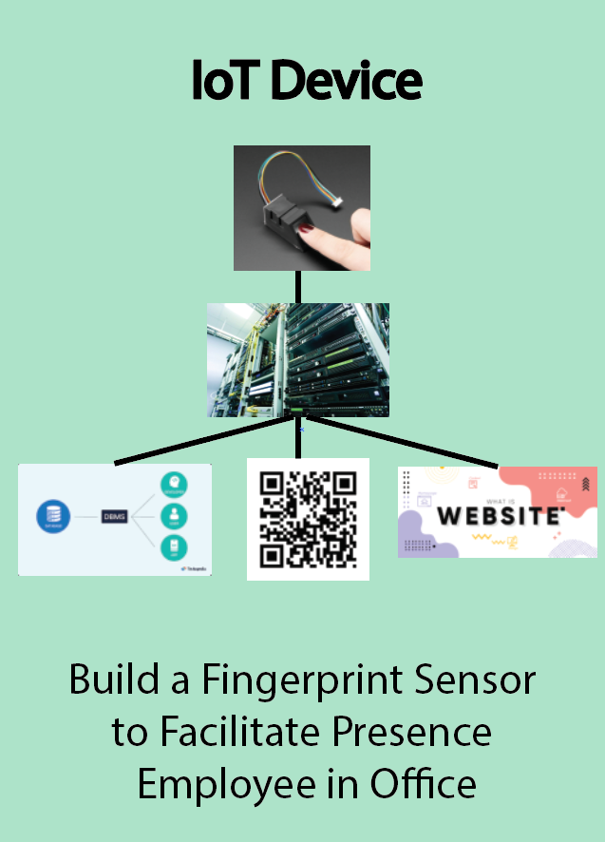
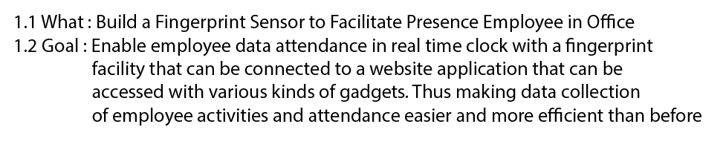
Solution Description

Slide 5
List Component
1.Micro HDMI to HDMI cable Rp8.900
2.Breadboard x1 Rp9.700
3.Raspberry pi 4 x1 Rp2.000.000
4.Ultrasonic Sensor x2 Rp18.000 (Rp9.000 pcs)
5.Humidity Sensor x2 Rp22.000
(Rp11.000 pcs)
6.Fingerprint Sensor x1 Rp119.000
7.RASPI CAM x1 Rp55.000
8.30cm Ribbon FFC Line 15pin Flat Wire Cable AS76 Rp7.000
9.LED light x1 Rp200
10.Servo x1 Rp38.000
11.LCD Touchscreen 7" x1 Rp665.000
12.Cable Jumper GPiO Raspberry Pi x1Rp13.000
13. USB TTL CH340 x1 Rp10.500
Total: Rp2.965.800

Slide 6
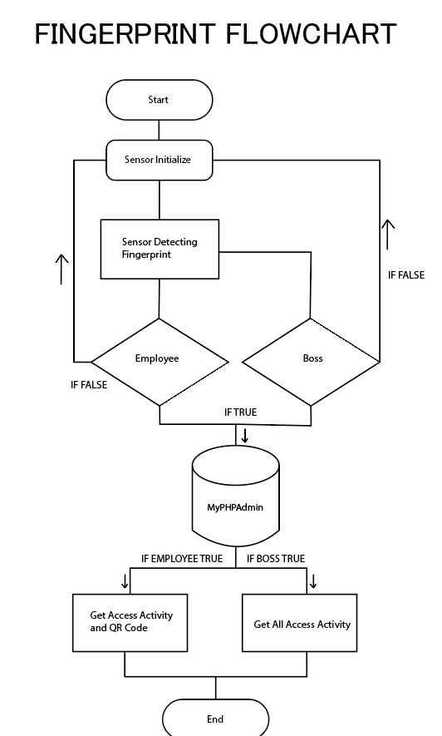
System Workflow and Design

Slide 7
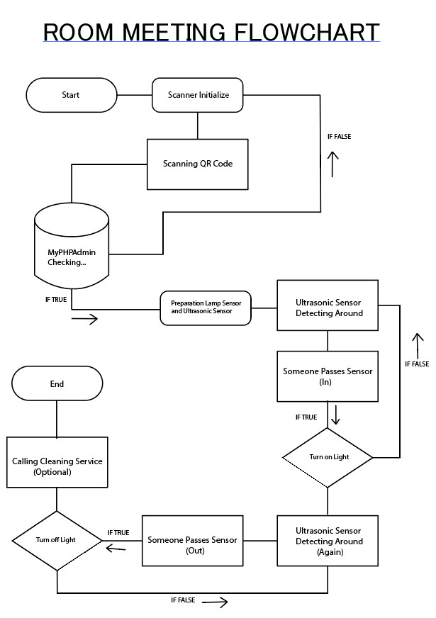
System Workflow and Design

Slide 8
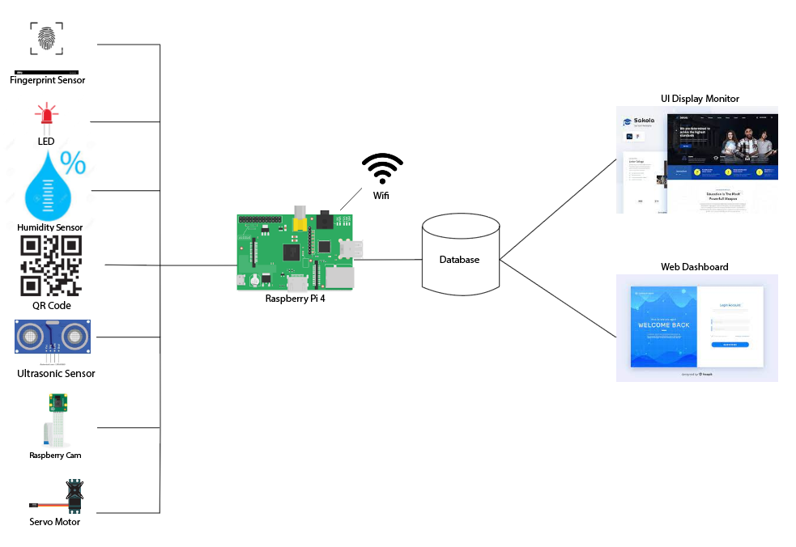
System Architecture

Slide 9
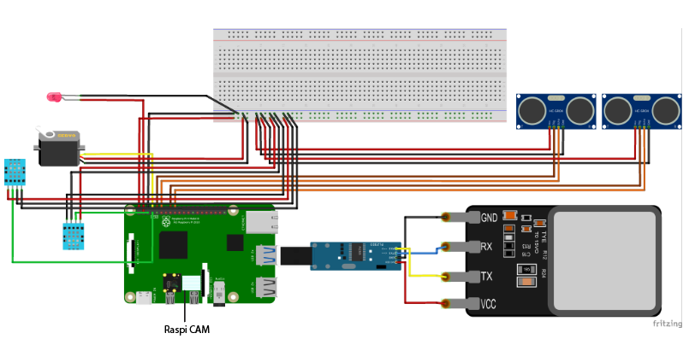
Wiring/Schematic Diagram

Slide 10
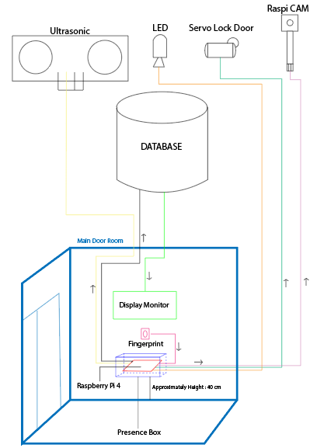
Casing/Mechanical Design

Slide 11
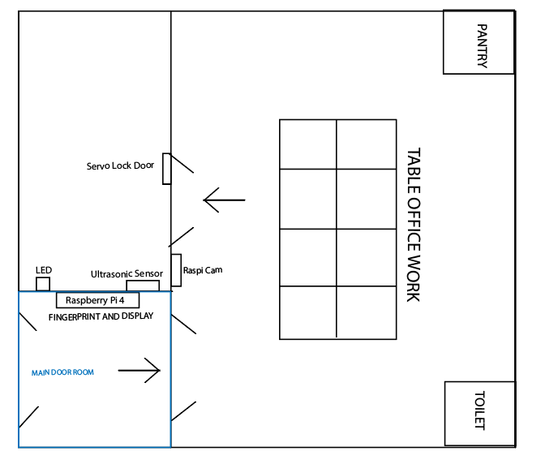
Casing/Mechanical Design

Slide 12
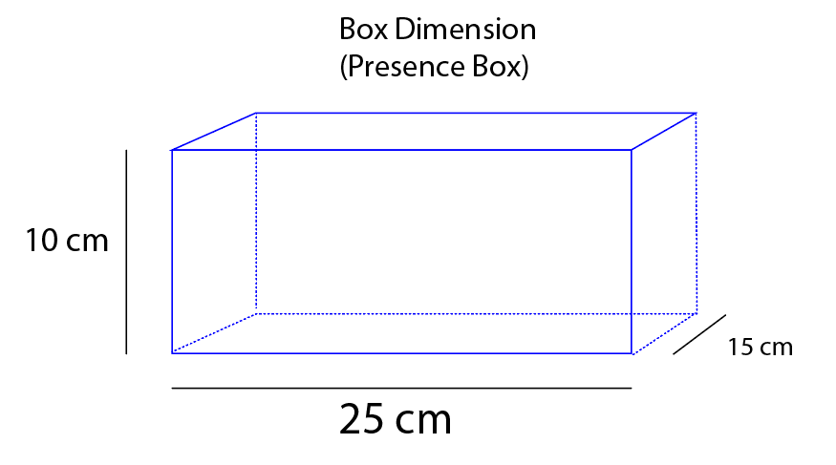
Casing/Mechanical Design

